Slide 1

EMAIL DATA ANALYSIS
GROUP 7
Robert Curtis
Bojue Deng
Yang Fu
Pushkar Kale
Wei Wang
https://pixabay.com/en/photos/email/

Slide 2

Introduction
The Enron scandal was known to the public in late October, 2001.
~ 0.6m emails were left as evidence for Enron bankruptcy investigation at that time.
Later on they became a resource for studies and research on social networking and computer analysis of language.
https://en.wikipedia.org/wiki/Enron#/media/File:Logo_de_Enron.svg
Notes:
background information of the dataset

Slide 3
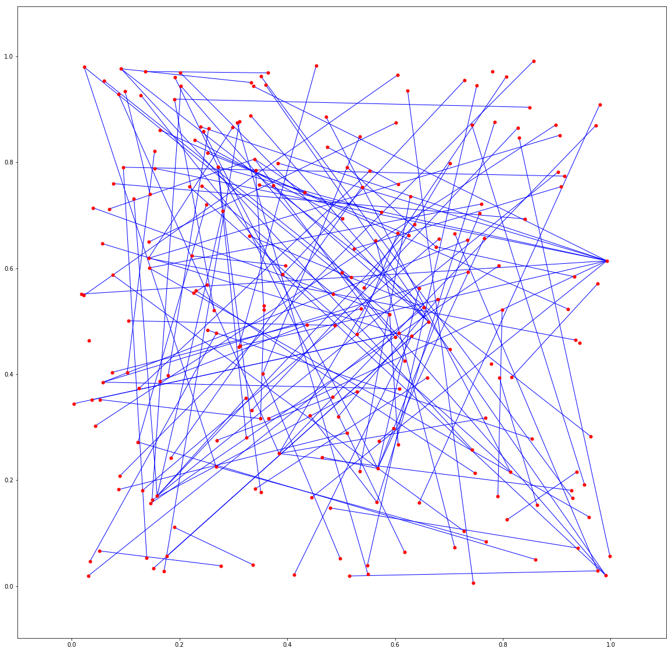
Data Exploration:
the Network Plot
200 emails
random _layout
Notes:
An example of network analysis

Slide 4

Problems of Interest
How did Enron employees react to the scandal ?
Was there a company-wide change of morale ?
What did they talk about in the emails ?
Notes:
questions we are interested

Slide 5
Methods -- Sentiment Analysis
Sentiment analysis
total sentiment of the email
average sentiment of the email
Box Plots
easy display of information

Slide 6
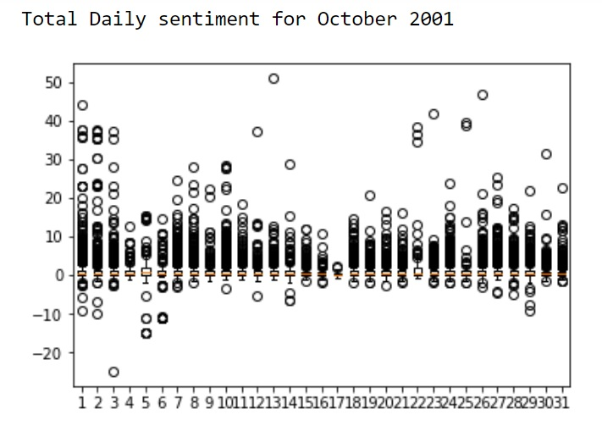
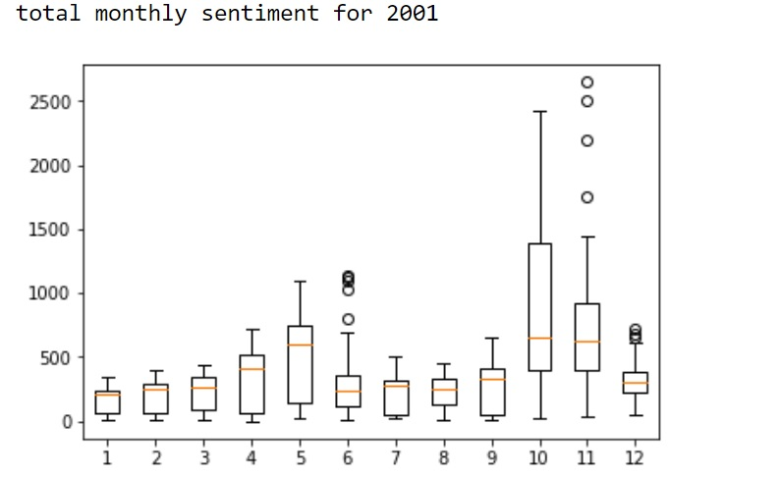
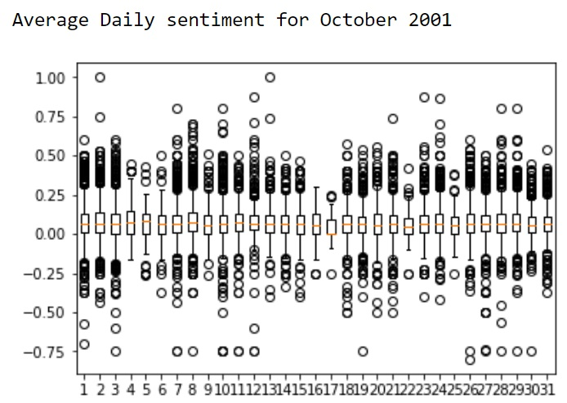
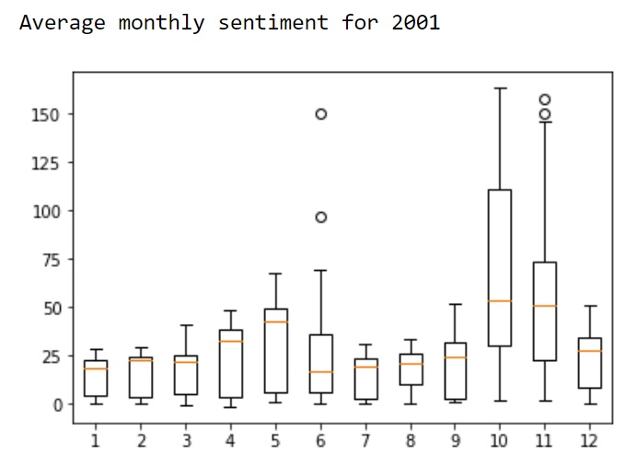
Sentiment Analysis Results
Total email sentiment by day(October 2001)
Total email sentiment by month(2001)
Averaged email sentiment by day(October 2001)
Averaged email sentiment by month(2001)

Slide 7
Methods -- Email Clustering
- Emails sent during Oct, 2001. # ~ 8000.
- Convert email contents to a term-document matrix using TF-IDF.
- Cluster with KMeans (K=3)
Notes:
Yang

Slide 8
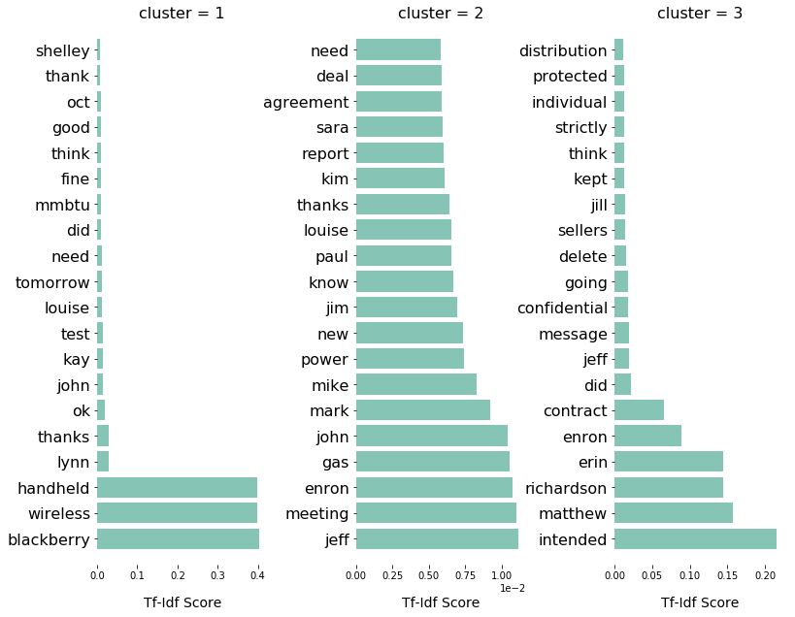
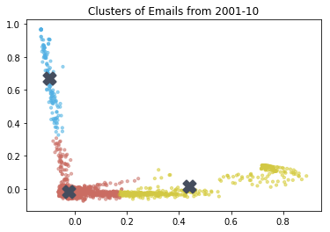
Email Clustering
Notes:
Yang

Slide 9
Conclusions
Emails are a great source to learn about people’s emotions and feelings.
Clustering of emails provides interesting insights on various keywords that appear in a collections of emails. Such keywords may represent people’s thoughts and actions.

Slide 10


https://pixabay.com/en/thank-you-text-message-note-394180/
ANY QUESTIONS?
https://www.flickr.com/photos/wingedwolf/5471047557

